Slide 1
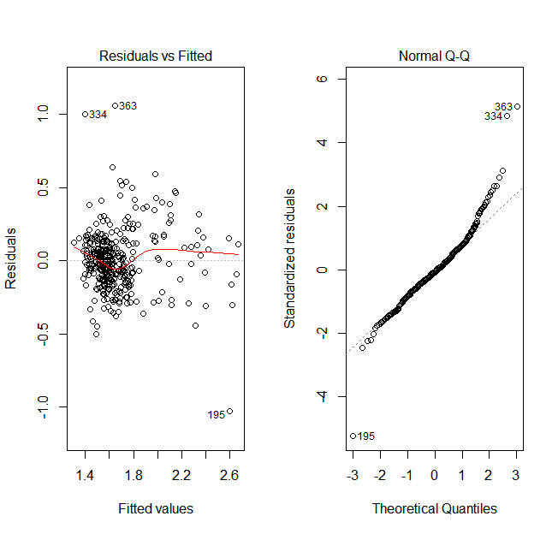
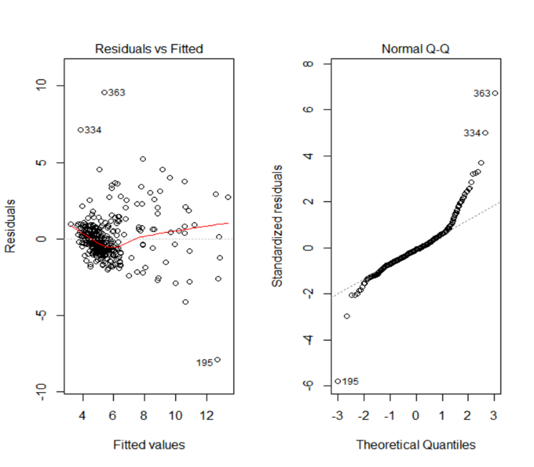
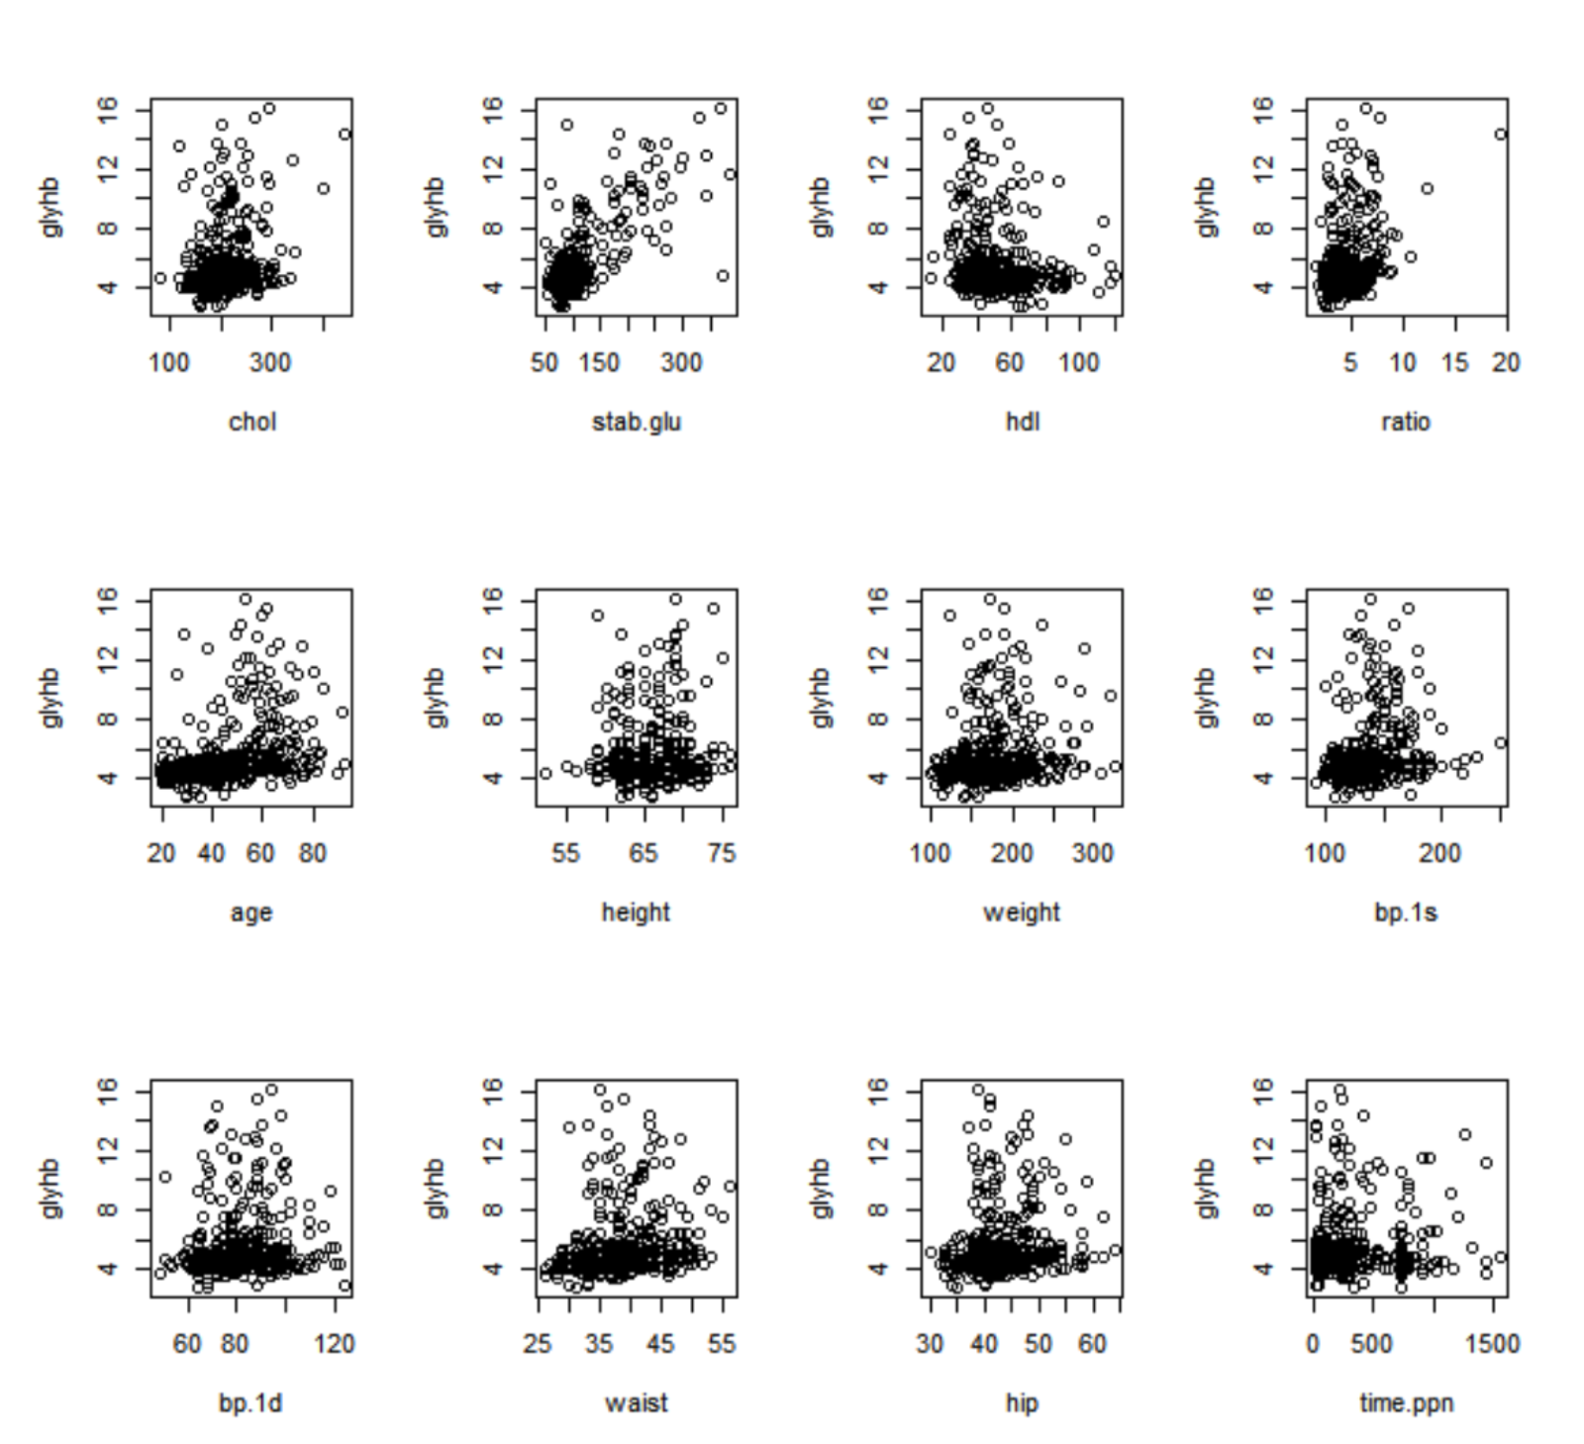
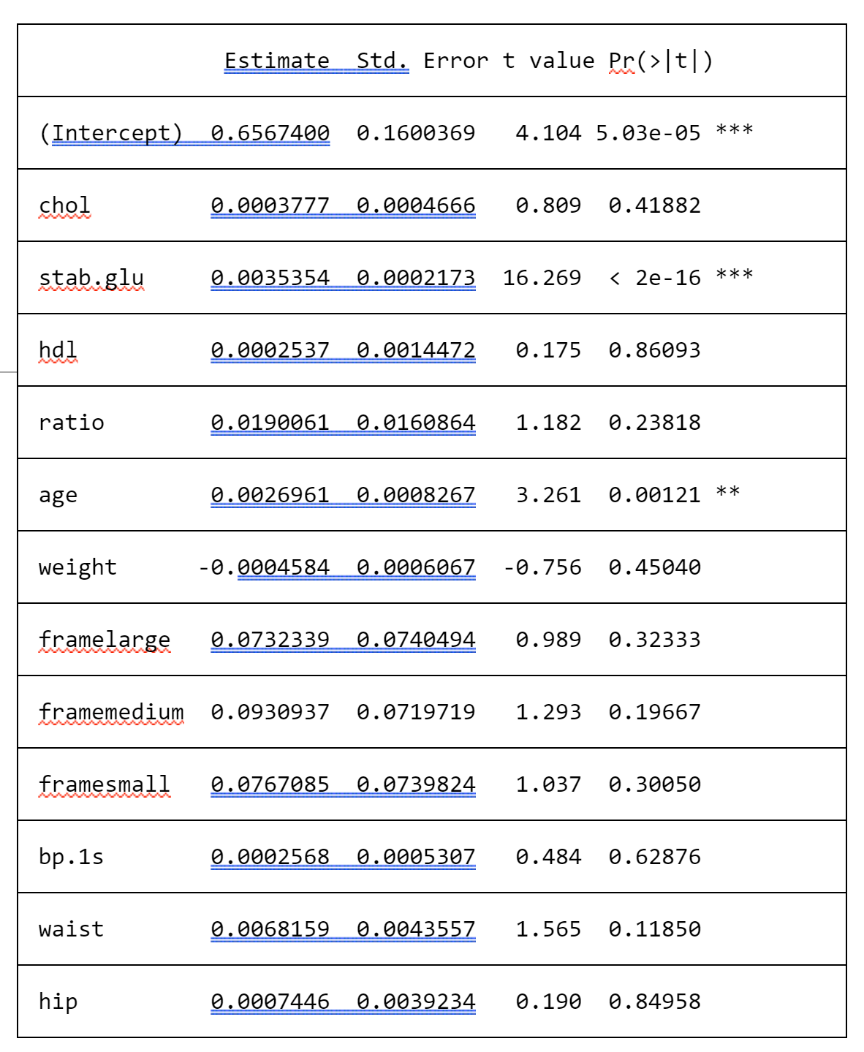

CS802
Research
Seminar
Predictive Model Construction for DM II
Author: Junbin Sun
Seidenberg School of CSIS, Pace University, Pleasantville, NewYork 10570
Email: js09442p @pace.edu
Abstract
Result and Conclusion
Abstract— Diabetes is a frequent metabolic disorder defined by chronic hyperglycemia, caused by a deficiency in the endocrine system. According to Dr. John Hong, Diabetes Mellitus Type II (DM II; adult onset diabetes) is associated most strongly with obesity. The waist/hip ratio or body mass index (BMI) may be a predictor of diabetes. DM II is also associated with hypertension. They may both be part of "Syndrome X.” “Syndrome X” or “metabolic syndrome” is a condition associated with an increased risk of diabetes and heart disease.
The disease is a major cause of morbidity as well as premature mortality because of long-term complications such as cardiovascular disease, blindness, kidney failure, and amputations 2–4. With early diagnosis and subsequent lifelong good glycemic control and early treatment of complications – the patient with diabetes can have a good life quality and reduce the risk of complications that compromise their well-being.This paper presents an overview of research in this area of predictive models within diabetes and the related complications. Furthermore, the paper focuses on two main areas in the use of predictive models within Type 2 diabetes. Keywords— DM II, Predictive models, Regression analysis, Bivariate analysis.
Method
After measuring and evaluating some descriptive statistics and visual plots, to get an overview of the relationship between predictors and response variables, we mainly use two sample t-tests to test the average Glycosylated hemoglobin levels in different category groups. We found that there is no significant difference in Glycosylated hemoglobin levels when varied with different levels of location and gender. We also use Pearson's correlation test to determine whether there is any significant correlation between each of the 12 continuous variables and Glycosylated hemoglobin.
The results show that three predictors: height, bp.1d and time.ppn are insignificant in having correlation with Glycosylated hemoglobin. While, using diabetes as the outcome, we use chi-test to test the independency between the category predictors and diabetes. We also find that location and gender are insignificant with diabetes as the outcome, so then we use t-tests to determine whether the average values of each of the 12 continuous predictors are different in the two diabetes groups or not. The results also show that height, bp.1d and time.ppn are insignificant and doesn’t contribute much. Thus, we perform regression analysis for Glycosylated hemoglobin and diabetes. We use linear regression for Glycosylated hemoglobin and logistic regression for diabetes. We remove the predictors, which are insignificant, as found by bivariate analysis, and perform a log transformation of Glycosylated hemoglobin.
Bivariate analysis
Bivariate analysis helps to analyze the relationship between two attributes. It further helps us to evaluate if there is an association between the variables and the significance of this association or if there are differences, the importance of those differences. In general, there are three types of bivariate analysis: Numerical & Numerical, Categorical & Categorical and Categorical & Numerical.
Pearson’s Chi-squared test
We know that diabetes is a binary outcome, so at first we generate the three contingency tables that make use of the three category predictors: location, gender, and frame. Now, we apply Pearson's Chi-squared test to find out if there occurs any dependency or independency between diabetes and the three category predictors. The Chi-square distribution gives us a probability for the computed Chi-square and we can analyze the degree of freedom. A probability of zero accounts for a complete dependency between the variables and a probability of one accounts for a complete independency between the variables. The Chi-square p-value is the probability conveyed by a Chi-square statistic that tells us how likely an observed distribution occurs as per chance. The contingency table containing the categorical variables: location and diabetes has the the Chi-square value of 0.127 and the p-value of 0.7216 from the Pearson’s Chi-squared test.
Regression analysis
We now carry out Regression analysis. Regression is a statistical measure that helps us to infer the strength of the relationship between a dependent variable and a series of other changing variables (known as independent variables). We perform two – regression analysis, one using Glycosylated hemoglobin as an outcome and the other one using the diagnosis of diabetes as an outcome. The first regression analysis is an ordinary linear regression while the second one is a logistic regression.
Linear Regression
Linear regression assesses how successfully a predictive variable does its job in predicting the outcome variable, which is Glycosylated hemoglobin here. From the Bivariate analysis, it is evident that there is no difference in the average of Glycosylated hemoglobin levels for the category variables: location and gender.
Logistic Regression
Now, we use the diabetes, which is a binary variable, as the outcome and perform a logistic regression. In logistic regression, the outcome (diabetes) has only a limited number of possible values, and it is used when the response variable is categorical in nature. Here also, we continue to use the same predictors as used in linear regression, which means that the five predictors: location, gender, height, bp.1d and time.ppn are all excluded from the logistic model. The summary table of the logistic model also shows that stab.glu and age are significant variables, exhibiting significant estimated coefficients.
Introduction
In this research, we have carried out studies to find out the predictors of two outcomes a) Glycosylated hemoglobin and b) diagnosis of diabetes. The dataset used is courtesy of Dr. John Schorling, Department of Medicine, and University of Virginia School of Medicine. The data consists of 19 variables on 403 subjects who were interviewed in a study to understand the prevalence of obesity, diabetes, and other cardiovascular risk factors in central Virginia for African Americans.
These 403 subjects had to undergo a screening process for diabetes. The parameter, which is tested, is Glycosylated hemoglobin. Glucose is bound to this hemoglobin. It is used to monitor the long-term control of DM II. The level of glycosylated hemoglobin depicts the average blood-glucose level over the past three months and for any normal person, it is less than 7%. Glycosylated hemoglobin > 7.0 is considered as a positive sign of diabetes. We have further constructed a predictive model according to the result we concluded from the analysis. By making predictions for the patient, the patient will be aware of the risks of DMII.
Fig. 2. Linear Regression with removed
unnecessary variables and NAs.
Fig. 3. Logistic Regression with removed
unnecessary variables and NAs.
Reference
1. Willems JP, Saunders JT, DE Hunt, JB Schorling: Prevalence of coronary heart disease risk factors among rural blacks: A community-based study. Southern Medical Journal 90:814-820; 1997 Schorling JB, Roach J, Siegel M, Baturka N, Hunt DE, Guterbock TM, Stewart HL: A trial of church-based smoking cessation interventions for rural African Americans. Preventive Medicine 26:92-101; 1997.
3. Wannamethee, S. Goya, et al. "Metabolic syndrome vs Framingham Risk Score for prediction of coronary heart disease, stroke, and type 2 diabetes mellitus." Archives of internal medicine 165.22 (2005): 2644-2650.
4. Knowler, William C., et al. "Reduction in the incidence of type 2 diabetes with lifestyle intervention or metformin." The New England journal of medicine 346.6 (2002): 393-403.
5. Lorenzo, Carlos, et al. "The metabolic syndrome as predictor of type 2 diabetes: the San Antonio heart study." Diabetes care 26.11 (2003): 3153-3159.
6. Collins, Gary S., et al. "Developing risk prediction models for type 2 diabetes: a systematic review of methodology and reporting." BMC medicine 9.1 (2011): 103.
Fig. 1. Scatter Plots for continuous variables.
The above figure depicts the variation of glycosylated hemoglobin with the 12 continuous variables.
Table 5: Regression result of final linear model for Glyhb
This presentation poster was designed by FPPT.
Notes:
You can add your presentation notes here. This presentation template for research posters is fully editable so text, graphics and content can be updated to fit your own research needs.
Download more poster presentation templates from FPPT.com

